Slide 1
Pericardial Disease
By:
Mohey Eldeen A. Eldeeb
Prof. of Cardiology

Slide 2
Indented Learning Outcomes (ILOs)
Pericarditis as a source of chest pain, clinical features, DD, investigations, and treatment.
Etiology and management of pericardial effusion.
Tamponade Diagnosis and early referral as a cardiac emergency.
Constrictive pericarditis, presentation and management.

Slide 3
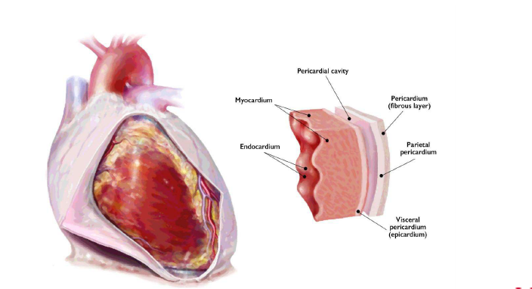
Anatomy and Physiology of the Pericardium

Slide 4
Diseases of the pericardium
Pericardial diseases may be either isolated disease or part of a systemic disease.
The main pericardial syndromes that are encountered in clinical practice include pericarditis, pericardial effusion, cardiac tamponade, constrictive pericarditis.

Slide 5
Acute Pericarditis
inflammatory syndrome with or without pericardial effusion with a wide variety of causes.
Despite relatively generally good prognosis, pericarditis usually recurs in one-third of patients without proper treatment.

Slide 6
Etiology of pericarditis
Idiopathic
85–90% of cases; likely related to viral infection, which may trigger immune-related process
Infectious
Viral: echovirus, coxsackievirus, adenovirus, cytomegalovirus, hepatitis B virus, infectious mononucleosis, HIV/AIDS
Bacterial : M. tuberculosis, M. avium-intracellulare, pneumococcus, staphylococcus, streptococcus, Mycoplasma, Lyme disease, H. influenzae, Neisseria meningitides, and many others.
Fungal (histoplasmosis, coccidioidomycosis)
Protozoal.

Slide 7
Etiology of pericarditis
Inflammatory
Connective tissue disease (systemic lupus erythematosus, rheumatoid arthritis, scleroderma, Wegener granulomatosis, spondyloarthropathies, Sarcoidosis mixed)
Drug-induced (e.g., procainamide, hydralazine, cyclosporine)
Arteritis (polyarteritis nodosa, temporal arteritis)
Inflammatory bowel disease

Slide 8
Etiology of pericarditis
Postpericardiotomy
After cardiac procedures (e.g., catheterization, pacemaker placement,ablation)
Medication-induced: dantrolene, doxorubicin, hydralazine, isoniazid, mesalamine, methysergide, penicillin, phenytoin, procainamide, rifampin

Slide 9
Etiology of pericarditis
Post MI
Acute MI early (2 to 4 days after MI), late (Dressler syndrome weeks to months after MI)
Miscellaneous
Aortic dissection
Renal failure, uremia, dialysis-associated
Malignancy
Radiation therapy
Trauma

Slide 10
Clinical diagnosis
Can be made with two of the following criteria:
chest pain (85–90% of cases) typically sharp and pleuritic, improved by sitting up and leaning forward.
pericardial friction rub (≤33% of cases) a superficial scratchy or squeaking sound over the left sternal border.
ECG changes (up to 60% of cases) with new widespread ST elevation or PR depression in the acute phase.
Pericardial effusion (up to 60% of cases, generally mild)

Slide 11
Clinical diagnosis
Additional signs and symptoms may be present according to the underlying aetiology or systemic disease (i.e. signs and symptoms of systemic infection such as fever and leucocytosis, or systemic inflammatory disease or cancer.
ECG: Widespread ST-segment elevation has been reported as a typical hallmark sign of acute pericarditis.
Elevation of markers of inflammation (CRP) and (ESR), as well as elevation of the white blood cell count] is a common and supportive finding in patients with acute pericarditis

Slide 12
Laboratory Testing
Elevation of markers of inflammation (CRP) and (ESR), as well as elevation of the white blood cell count] is a common and supportive finding in patients with acute pericarditis.
Chest radiograms are normal in uncomplicated acute pericarditis.
The echocardiographic-Doppler examination is completely normal in approximately 40% of patients with acute pericarditis. It is performed mainly to determine if an effusion is present and recommended in all patients with suspected pericarditis.

Slide 13
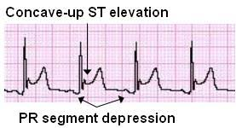
Differential diagnosis
Chest pain from acute pericarditis can mimic
-Aortic dissection
-Pulmonary embolism
-Pneumothorax
-ACS (STEMI).
ST-elevations in pericarditis are usually upsloping and concave with upright T-waves in contrast to horizontal or downsloping convex ST-elevation seen in acute ST-elevation myocardial infarction.
-Echocardiography may help in making the distinction by assessing for wall motion abnormalities, which are usually absent in acute pericarditis.

Slide 14
Predictors of poor prognosis
Major
• Fever > 38˚C
• Subacute onset
• Large pericardial effusion
• Cardiac tamponade
• Lack of response to aspirin or NSAIDs after at least 1 week of therapy
Minor
• Myopericarditis
• Immunosuppression
• Trauma
• Oral anticoagulant therapy.

Slide 15
Complications
Recurrent pericarditis: occurs in ~30% of patients, with most instances resulting from idiopathic, viral, or autoimmune pericarditis; inadequate treatment of the initial attack; and, less commonly, neoplastic etiologies.
Recurrence usually within 1st week following initial episode but may occur months to years later; rarely associated with tamponade/ constriction
About 5% of patients develop corticosteroid dependence and colchicine resistance.

Slide 16
Complications
Cardiac tamponade: rare complication with increased incidence in neoplastic, purulent, and tuberculous pericarditis
Constrictive pericarditis: rare complication in which rigid pericardium produces abnormal diastolic filling with elevated filling pressures. Pericardiectomy remains definitive therapy.

Slide 17
Treatment of pericarditis
Initial management is focused on
Confirming the diagnosis
Screening for specific causes that would alter management
Detection of effusion and other echocardiographic abnormalities
Alleviation of symptoms
Outpatient therapy is successful in low-risk patients.
Appropriate treatment if a specific cause is discovered

Slide 18
Treatment of pericarditis
Acute idiopathic pericarditis is a self-limited disease without significant complications or recurrence in 70% to 90% of patients.
Restriction of physical activity.
Symptomatic treatment with nonsteroidal antiinflammatory drugs (NSAIDs) is recommended.
Ibuprofen 600 to 800 mg orally three times daily, or ASA 750 to 1000 mg orally three times daily.
Colchicine is recommended for 3 months as an adjunct to NSAIDs.
Tapering should be done only if the patient is asymptomatic and CRP/ESR are normal.
GI protection should be provided

Slide 19
Treatment of pericarditis
Corticosteroid use should be minimized in patients with acute pericarditis in selected indications:
Contraindications to or failure of an NSAID and colchicine.
Underlying conditions (e.g., autoimmune diseases) whose primary treatment is corticosteroids
Concomitant diseases (e.g., renal failure)
Pregnancy

Slide 20
Treatment of recurrent pericarditis
Therapy should be targeted at the underlying aetiology in patients with an identified cause.
Aspirin or NSAID, colchicine and exercise restriction.
Low-dose corticosteroids (in case of contraindications to aspirin/NSAID/colchicine and after exclusion of infectious cause)
i.v. immunoglobulin or anakinra or azathioprine
Pericardiectomy

Slide 21
Pericardial Effusion
Accumulation of >50 mL of pericardial fluid within the pericardial cavity leading to a pericardial effusion.
Virtually any disease that can cause pericarditis can cause an effusion.
The most common causes of pericardial effusion in developed countries include idiopathic (50%), neoplastic (10% to 25%), infections (15% to 30%), iatrogenic (15% to 20%), and autoimmune (5% to 15%)

Slide 22
Pericardial Effusion
Any pathological process usually causes an inflammation with the possibility of increased production of pericardial fluid (exudate).
An alternative mechanism of accumulation of pericardial fluid may be decreased reabsorption due to increase in systemic venous pressure as a result of CHF or pulmonary hypertension (transudate).
Bleeding into the pericardial sac (hemopericardium) after trauma, post-MI rupture of the LV free wall, and as a complication of cardiac procedures.
Retrograde bleeding is a major cause of death due to aortic dissection

Slide 23
Clinical presentation
The clinical presentation of pericardial effusion varies according to the speed of pericardial fluid accumulation. If it is rapidly accumulating, even small amounts may cause cardiac tamponade.
On the other hand, a slow accumulation of pericardial fluid allows the collection of a large effusion in days to weeks before a significant increase in pericardial pressure causes symptoms and signs.

Slide 24
Clinical presentation
Classic symptoms include dyspnoea on exertion progressing to orthopnoea, chest pain and/or fullness.
Additional occasional symptoms due to local compression may include nausea (diaphragm), dysphagia (oesophagus), hoarseness (recurrent laryngeal nerve) and hiccups (phrenic nerve).
Non-specific symptoms include cough, weakness, fatigue, anorexia and palpitations.

Slide 25
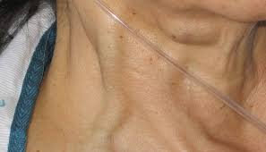
Clinical presentation
Physical examination may be absolutely normal in patients without haemodynamic compromise.
When tamponade develops, classic signs include neck vein distension with elevated jugular venous pressure, pulsus paradoxus and diminished heart sounds, Pericardial friction rubs are rarely heard.

Slide 26
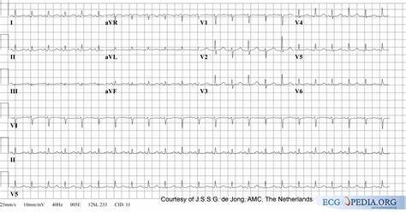
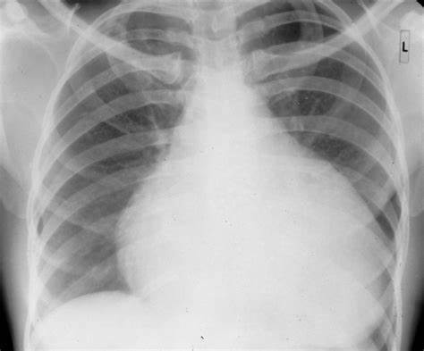
Investigations

Slide 27
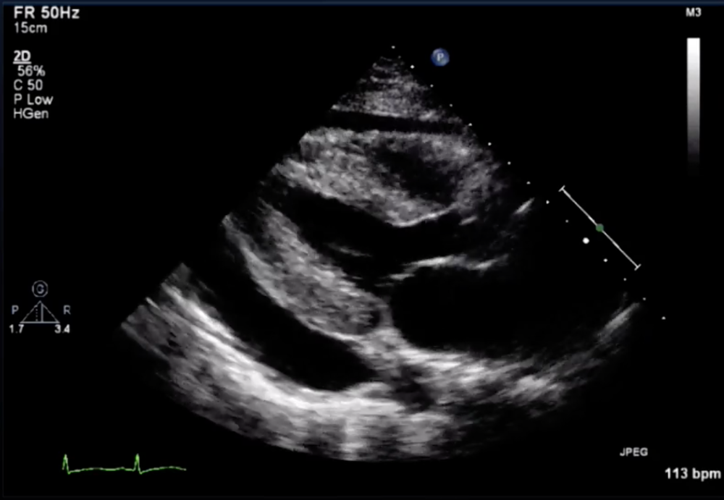
Investigations

Slide 28
Investigations

Slide 29
Therapy

Slide 30
Therapy

Slide 31
Cardiac Tamponade
Pericardial compressive syndromes as a complications of acute pericarditis include cardiac tamponade, constrictive pericarditis, and effusive-constrictive pericarditis.
Cardiac tamponade is is a potentially fatal condition characterized by impaired ventricular diastolic filling caused by an increase in intrapericardial pressures because of the accumulation of pericardial fluid.
Virtually any disease that can cause pericarditis can cause an effusion.

Slide 32
Cardiac Tamponade
The spectrum of tamponade ranges from compensated tamponade to cardiogenic shock.
The development of cardiac tamponade is determined by the interplay between pericardial stiffness (infiltrations, calcification, or fibrosis), size of effusion, and rate of fluid accumulation.

Slide 33
Pathophysiology of Cardiac Tamponade
The pericardium is able to distend in response to fluid accumulation until a limit on its ability to stretch is reached.
Beyond this, small increments in pericardial fluid volume result in large increases in intrapericardial pressure

Slide 34
Pathophysiology of Cardiac Tamponade
High intra-pericardial pressure → decreased venous return → decreased diastolic ventricular filling → reduction in intracardiac volumes.
The cardiac output is initially maintained by a heightened adrenergic tone, resulting in a resting tachycardia and peripheral vasoconstriction, Finally compensatory mechanisms fail, resulting in decreased CO → hypotension and venous congestion

Slide 35
Clinical presentation
The signs and symptoms of cardiac tamponade all reflect a low cardiac output: restlessness, agitation, drowsiness, or stupor; decreased urine output; dyspnea; chest discomfort and syncope or near syncope; and weakness, anorexia, and weight loss with a chronic effusion.
Tachypnea, dyspnea, shock, muffled heart sounds
Pulsus paradoxus (inspiratory fall in systolic BP >10 mmHg during quiet breathing)
JVP “x” descent only, blunted “y” descent
Hepatic congestion/peripheral edema

Slide 36
Clinical presentation
Physical examination usually reveals Beck’s Triad
Hypotension
Increased JVP
Muffled heart sounds
DD from Constrictive Pericarditis

Slide 37
Investigations
ECG: electrical alternans (pathognomonic variation in R wave amplitude), low voltage
Echo: must be performed emergently when the diagnosis of cardiac tamponade is suspected, pericardial effusion, compression of cardiac chambers (RA and RV) in diastole
Advanced imaging with cardiac CT and MRI are second-line imaging modalities reserved for subacute complex cases.
Cardiac catheterization is occasionally used in “borderline” cases.

Slide 38
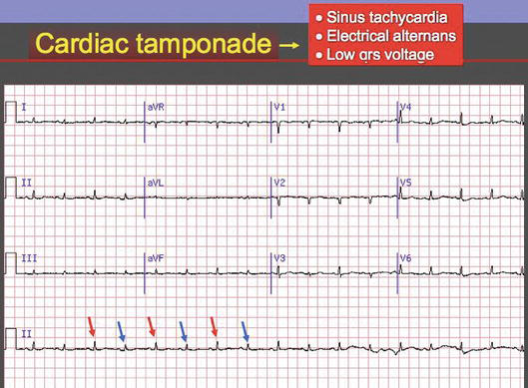
Cardiac Tamponade ECG

Slide 39
Treatment
Prompt drainage of pericardial fluid is the most important intervention.
Pericardiocentesis: Echo-guided
Pericardiotomy
Avoid diuretics and vasodilators (these decrease CO)
IV fluid may increase CO
Treat underlying cause

Slide 40
Constrictive Pericarditis
A noncompliant pericardium, usually as a consequence of inflammation, fibrosis, or calcification, which encases the heart leading to heart failure because of impaired diastolic ventricular filling.
Can be caused by any pericardial process , Major causes are idiopathic, post-infectious (viral, TB), radiation, post-cardiac surgery, uremia, MI, collagen vascular disease

Slide 41
Pathophysiology of Constrictive Pericarditis
Can be classified:
Transient constrictive pericarditis, defined as a transient form of constriction because of inflammation rather than scarring that resolves by itself or with 3 to 6 months of antiinflammatory therapy.
Effusive–constrictive pericarditis is described in patients with pericardial tamponade in whom intracardiac pressures remain elevated despite pericardiocentesis.
Chronic constrictive pericarditis is defined as persistent constriction after 3 to 6 months duration

Slide 42
Clinical Presentation
The early symptoms of constrictive pericarditis are often insidious and nonspecific including malaise, fatigue, and decreased exercise tolerance.
As the disease progresses, patients complain predominantly of right-sided heart failure symptoms including peripheral edema, hepatic congestion, ascites, and worsening exercise tolerance.

Slide 43
Physical examination
Patient with constriction commonly reveals the following:
Increased JVP, Kussmaul’s sign (paradoxical increase in JVP with inspiration), Friedreich’s sign (prominent “y” descent)
Congestive hepatosplenomegaly, Ascites, edema.May mimic CHF (especially right-sided HF)
Precordial examination: muffled heart sounds ± pericardial knock (early diastolic sound)

Slide 44
Investigations
ECG: usually reveals a low voltage with generalized flattening of the T-waves, ± AF
CXR: reveals pericardial calcification in 30% of cases, effusions.
Echo/CT/MRI: pericardial thickening, ± characteristic echo-Doppler findings
Cardiac catheterization: assists in both diagnosing constrictive pericarditis and differentiating it from restrictive cardiomyopathy.

Slide 45
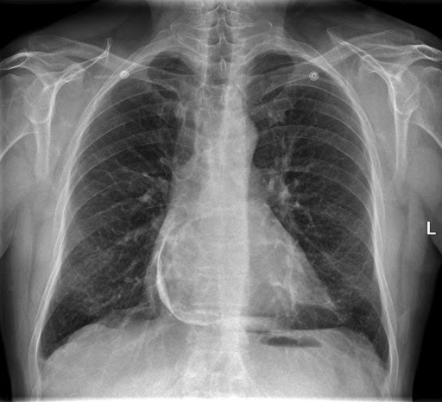
Pericardial Calcification

Slide 46
Treatment
Medical: in certain clinical scenarios
-Anti-inflammatory therapy for 3 to 6 months.
-Diuretics, salt restriction
Pericardiocentesis with the previous medical therapy before recommending pericardiectomy
Surgical: Pericardiectomy is the preferred treatment (only if refractory to medical therapy), provides symptomatic improvement in more than 90% of patients.
Prognosis best with idiopathic or infectious cause and worst in post-radiation; death may result from heart failure

Slide 47
Thank You

